Slide 1
Introduction to
C Programming

Slide 2
A Brief History
Created by Dennis Ritchie at AT&T Labs in 1972
Originally created to design and support the Unix operating system.
There are only 27 keywords in the original version of C.
  for, goto, if, else ……
Easy to build a compiler for C.
  Many people have written C compilers
  C compilers are available for virtually every platform
In 1983 the American National Standards Institute (ANSI) formed a committee to establish a standard definition.
  Called ANSI Standard C.
  As opposed to K&R C (referring to the general “standards” that appeared in the first edition of Brian Kernighan and Ritchie’s influential book: The C Programming Language)

Slide 3
Why use C?
C is intended as a language for programmers
  BASIC was for nonprogrammers to program to solve simple problems.
  C was created, influenced, and field-tested by working programmers.
C is powerful and efficient
  You can nearly achieve the efficiency of assembly code.
  System calls and pointers allow you do most of the things that you can do with an assembly language.
C is a structured language
  Code can be written and read much easier.
C is standardized
  Your ANSI C program should work with any ANSI C compiler.

Slide 4
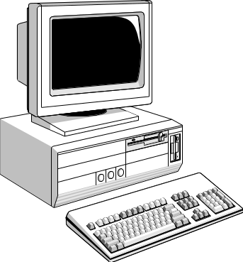
The C Development Cycle
Edit
Program
Source
Code
Compile
Object
Code
Library
Files
Executable
Link Object
Code

Slide 5
“Hello World”
Everyone writes this program first
#include <stdio.h>
int main ( )
{
  printf ("Hello, World!\n");
return 0;
}

Slide 6
Compilation (1)
Compilation translates your source code (in the file hello.c) into object code (machine dependent instructions for the particular machine you are on).
  Note the difference with Java:
    The javac compiler creates Java byte code from your Java program.
    The byte code is then executed by a Java virtual machine, so it’s machine independent.
Linking the object code will generate an executable file.
There are many compilers for C under Unix
  SUN provides the Workshop C Compiler, which you run with the cc command
  There is also the freeware GNU compiler gcc

Slide 7
Compilation (2)
To compile a program:
  Compile the program to object code.
    obelix[2] > cc –c hello.c
  Link the object code to executable file.
    obelix[3] > cc hello.o –o hello
You can do the two steps together by running:
    obelix[4] > cc hello.c –o hello
To run your program:
    obelix[5] > ./hello
    Hello World!
If you leave off the
-o, executable goes into
the file a.out

Slide 8
Compilation (3)
Error messages are a little different than you may be used to but they can be quite descriptive.
Suppose you forgot the semi-colon after the printf
    obelix[3] > cc hello.c –o hello
    "hello.c", line 5: syntax error before or at: return
    cc: acomp failed for hello.c
Notice that the compiler flags and informs you about the error at the first inappropriate token.
  In this case, the return statement.
Always try to fix problems starting with the first error the compiler gives you - the others may disappear too!

Slide 9
Example 1
/* program to compute area of a circle */
#include <stdio.h>
int main ()
{
int radius, area;
  printf ("Enter radius (i.e. 10) : ");
  scanf ( "%d", &radius);
  area = 3.14159 * radius * radius;
  printf ("\nArea = %d\n\n", area);
  return 0;
}

Slide 10
Example 2
/* print a triangle of A’s */
#include <stdio.h>
int main ()
{
int i, j;
for (i = 0; i < 10; i++) {
printf ("\n");
for (j = 0; j < i+1; j++ )
printf ( "A");
}
printf("\n");
return 0;
}

Slide 11
Example 3
/* Program to calculate the product of two numbers */
#include <stdio.h>
int product(int x, int y);
int main ()
{
int a,b,c;
/* Input the first number */
printf ("Enter a number between 1 and 100: ");
scanf ("%d", &a);
/* Input the second number */
printf ("Enter another number between 1 and 100: ");
scanf ("%d", &b);
/* Calculate and display the product */
c = product (a, b);
printf ("%d times %d = %d \n", a, b, c);
return 0;
}
/* Functions returns the product of its two arguments */
int product (int x, int y)
{
return (x*y);
}

